Slide 1


Marie Sklodowska-Curie
French National Contact Point

Slide 2


Overview
Presentation of the French NCP
Activities :
Promoting the MSCA, Informing and raising awareness
Assisting, advising and training
Other activities

Slide 3
Presentation of the NCP
1
The French MSCA NCP has officially been appointed by the French Ministry of National Education, Higher Education and Research.
The « French Rectors Conference » ensures the coordination of the NCP
The NCP is composed of 8 members
The coordinator dedicates between 30% and 50% of her working time to the NCP
The members dedicate about 20% of their working time to the NCP

Slide 4
Composition of the NCP
2
Four representatives from Universities :
Sandrine Schott, the coordinator, from the University of Strasbourg (Northeast of France)
Cyrielle Tirman from the University of Lille (North of France)
Sophie Beaubron from the University of Grenoble (Southeast of France)
Jean-Marie Pincemin from the University of Poitiers (Southwest of France)
Martine Roussel : representative of the Programme Committee
Two representatives from Research Organisations :
Koralia Pavlaki from the CNRS (National Center for Scientific Research), specialist in legal issues
Morgane Bureau from INSERM (French National Institute of Health and Medical Research)
A representative from the non-academic sector, Jean-Jacques Bernardini, who comes from « Alsace Innovation », an organisation which supports companies in the development of their innovative projects

Slide 5
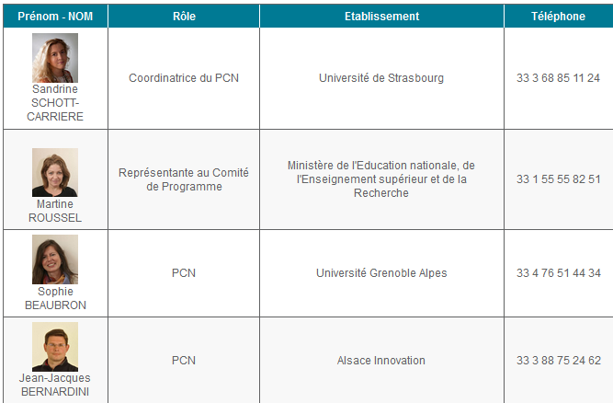
The website
3

Slide 6
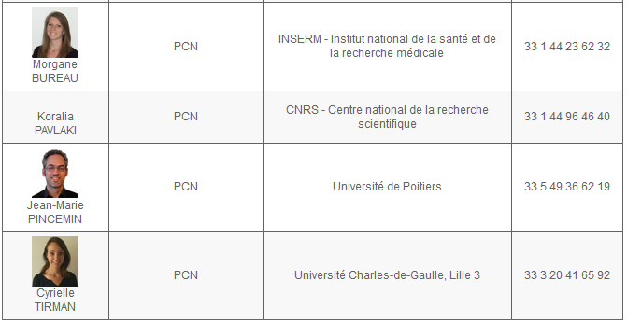
Composition
4
http://www.horizon2020.gouv.fr/cid73946/le-point-contact-national-actions-marie-curie.html

Slide 7
Overview
Presentation of the French NCP
Activities :
Promoting the MSCA, Informing and raising awareness
Assisting, advising and training
Other activities : Analyzing the results; preparing the Programme Committee

Slide 8
Informing and raising awareness
1
Organisation of national events (2016) :
Four training sessions on IF, ITN, RISE and Cofund (with the participation of REA, evaluators and project leaders)
Information day on the « evaluation process »
Information day on the « management of the projects »
About 540 participants

Slide 9

Informing and raising awareness
2
Participation in regional events (2016) :
Sometimes with other NCPs (ERC and FET)
We adapt the presentations depending on the requests : global presentations, specific training sessions, face to face meetings…
19 events
About 690 participants

Slide 10
Informing and raising awareness
3
Dissemination of information
By email : our mailing list is regularly updated (about 1400 suscribers)
News on our website
Toolbox :
Presentations
Flyers
Analysis of Evaluation Summary Reports
FAQs
Training materials
Links for search partners

Slide 11
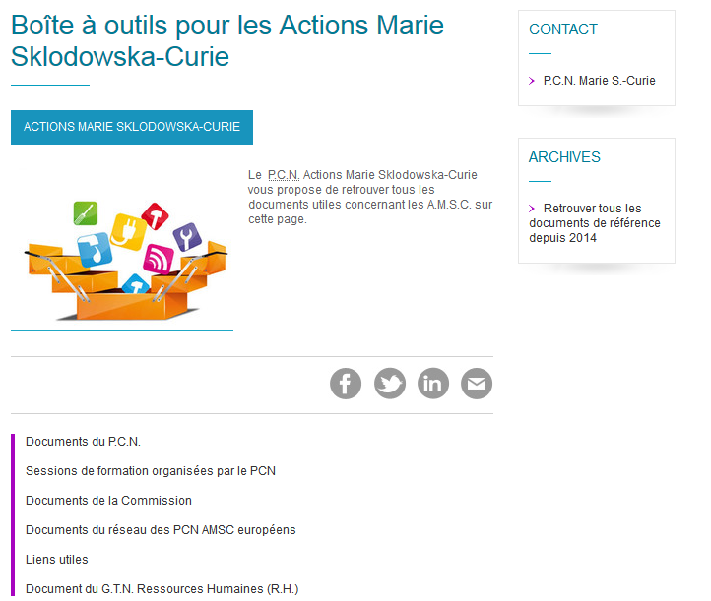
Informing and raising awareness
4
http://www.horizon2020.gouv.fr/cid79134/boite-outils-pour-les-actions-marie-sklodowska-curie.html

Slide 12
Assisting, advising and training
5
A generic email address :
All members receive and answer the questions
Two referents per action
pcn-mariescurie@recherche.gouv.fr
Support by email and phone
Training events (at regional and national levels)
Individual meetings with applicants
We do not proofread the applications

Slide 13
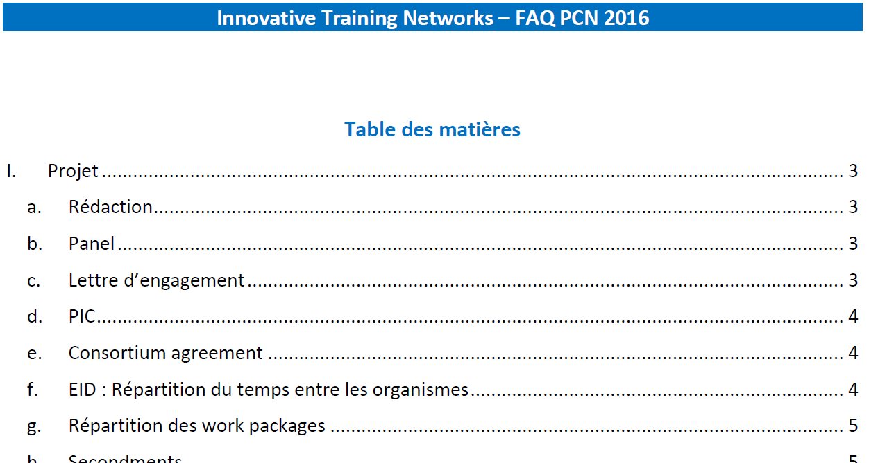
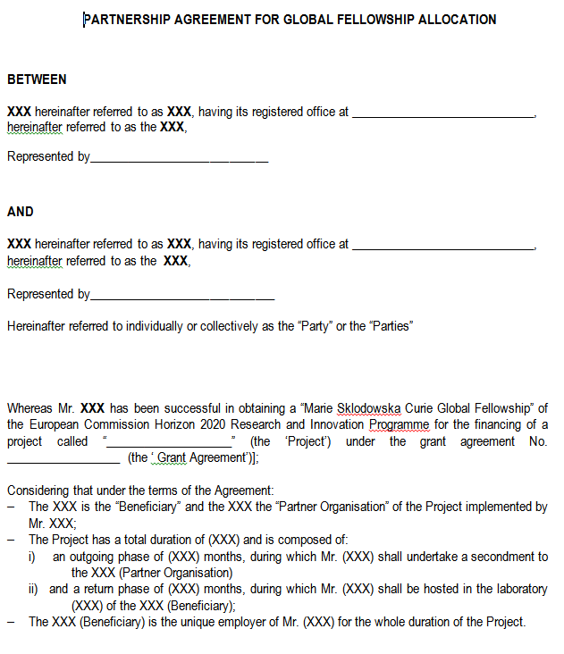
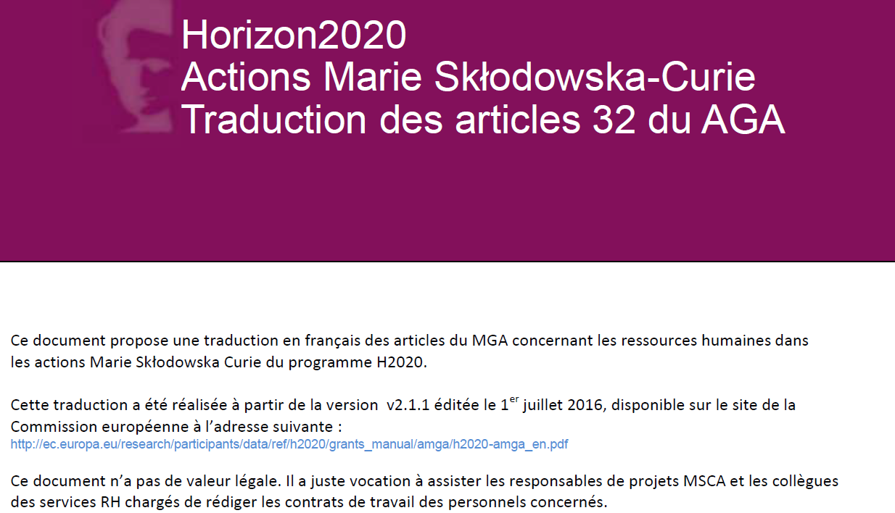
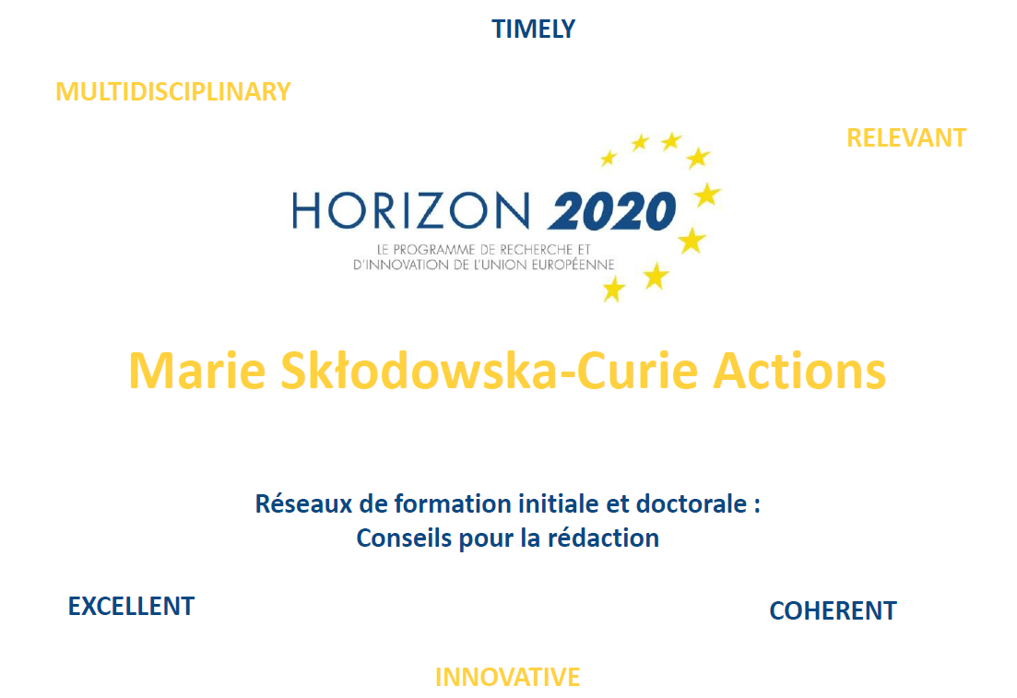
Assisting, advising and training
6

Slide 14
Other activities
7
Annual analysis of French results
Statistics
Working groups at national and european levels (Ministry of Research/Club of associated research organisation/Preparation of FP9…)
Continuous training : train the trainers; H2020 legal and financial rules…
Preparation of the Programme Committee (scoping paper…)

Slide 15
Thank you!
pcn-mariescurie@recherche.gouv.fr

