Slide 1
Publishing: an Editor‘s Perspective
Cameron Tropea
Institute for Fluid Mechanics and Aerodynamics
Center of Smart Interfaces, TU Darmstadt, Germany
Maria Curie Alumni Association (MCAA)
Center of Smart Interfaces
June 10th, 2015

Slide 2
Contents
Self-Introduction
Aims of the Editorial Staff, Scope statement
Submission Step
  Ethical Standards
  Suggested referees
Peer-Review Process
  General description
  Selection of reviewers
  Difficult judgements, adjudication
Editorial staff - composition
Measures of evaluation
Editor / publisher
  Statistics, production
  Marketing
Discussion, Questions and Answers

Slide 3
Self-Introduction
Prof. Dr.-Ing. Cam Tropea
Fachgebiet Strömungslehre und Aerodynamik
Technische Universität Darmstadt
Petersenstr. 30, 64287 Darmstadt, Germany
www.sla.tu-darmstadt.de
Degrees
B.A.Sc 1976 University of Toronto, Engineering Science
M.A.Sc. 1977 University of Toronto, Mechanical Engg.
Dr.-Ing. 1982 Universität Karlsruhe, Inst. für Hydromechanik
Dr.-Ing. habil. 1991 Universität Erlangen-Nürnberg
Positions
1985-1986 Visiting Professor, University of Waterloo
1991-1992 General Manager, Invent GmbH, Erlangen
1992-1997 Prof. Universität Erlangen-Nürnberg
1997 - Prof. Technische Universität Darmstadt

Slide 4
Contents
Self-Introduction
Aims of the Editorial Staff, Scope statement
Submission Step
  Ethical Standards
  Suggested referees
Peer-Review Process
  General description
  Selection of reviewers
  Difficult judgements, adjudication
Editorial staff - composition
Measures of evaluation
Editor / publisher
  Statistics, production
  Marketing
Discussion, Questions and Answers

Slide 5
Aims of Editorial Staff
Sustained publication of high-quality papers reporting on relevant science
Processing times commensurate with the expectations of the authorship/readership

Slide 6
Scope Statement
The scope statement must define the subject material considered appropriate for publication in the journal
Furthermore, the type of articles published should be clearly identified, e.g.
  Regular article (typical no. of pages or page limit)
  Short communication
  Review article (solicited or response mode)
  Design note
  Letter (for rapid communication)
The scope statement must be defined jointly by the publisher and editor(s) It is a definitive guideline for subsequent editorial decisions

Slide 7
Scope Statement, e.g. EXIF
Experiments in Fluids examines the advancement, extension, and improvement of new techniques of flow measurement. The journal also publishes contributions that employ existing experimental techniques to gain an understanding of the underlying flow physics in the areas of turbulence, aerodynamics, hydrodynamics, convective heat transfer, combustion, turbomachinery, multi-phase flows, and chemical, biological and geological flows. In addition, readers will find papers that report on investigations combining experimental and analytical/numerical approaches.

Slide 8
Types of Articles : EXIF
Research Articles have a recommended length of 10-12 published pages, referees will be asked to comment specifically on the manuscript length for manuscripts exceeding this limit. Authors can estimate the length of their manuscript using the following conversion: 1 page text contains approx. 4300 characters (750 words) or 6-8 figures. Multiple part manuscripts are highly discouraged and will generally be sent back to the authors and not accepted for review.
Letters have a shorter publication time and provide an opportunity to rapidly disseminate novel results expected to have an immediate impact in the experimental fluid mechanics community. Upon submission, Letter manuscripts should be accompanied by a justification for communicating the work in such a concise and timely manner. Letters should include a short abstract, should not exceed four journal pages and about 10 citations. Letters requiring more than minor revisions after the first review will typically be handled subsequently as a regular Research Article; otherwise they can be expected to be published in approximately two months.
Review articles provide readers with assessments of advances, as well as projected developments in key areas of experimental fluid mechanics. We expect that a typical review article will occupy twelve to fifteen pages in journal format, and have a substantial number of citations, which justify the comprehensive nature of the review.

Slide 9
Scope Statement:
Meas. Sci. & Techn. (MS&T)
Subject coverage. The theory, practice and application of measurement in physics, chemistry, engineering and the environmental and life sciences from inception to commercial exploitation. Its scope includes
  sensors, instruments and systems for physical, chemical and biological measurands
  sensor applications, micro- and nano-systems
  signal processing techniques for measurement and sensor-actuator systems
  metrology and the theory of measurement, including data and error analysis, standards and calibration.
The full range of transduction principles and measurement techniques are covered, including
  sensors (mechanical, chemical, thermal, biological, magnetic, radiation, fibre optic)
  fluid flow measurement, particle sizing, combustion measurements
  optical and laser based measurement techniques
  imaging techniques, including tomography, microscopy and holography
  spectroscopy, including MS, NMR, ESR, IR, UV-VIS, PCS, fluorescence, optical interferometry, dielectric, acoustic spectroscopy
  biomedical instrumentation
  micro-, nano- and picoscale measurement
  cryogenic science and measurement
  dimensional, thermal and optical metrology
  methods based on visible, infrared, x-ray or other electromagnetic radiation
  electrical and magnetic measurements including frequency and dielectric measurements
  acoustic and ultrasonics
  nuclear measurements

Slide 10
Types of Articles: MS&T
Papers. Reports of original research work; not normally more than 8500 words (10 journal pages). Papers on new instruments should include some representative results. Claims for originality of instrument design or novelty of measurement technique should be clearly stated in the abstract.
Design notes. Brief contributions on current design, development and application work; not normally more than 2500 words (3 journal pages), including descriptions of apparatus or techniques developed for a specific purpose, important experimental or theoretical points and novel technical solutions to commonly encountered problems.
Rapid communications. Brief, urgent announcements of significant advances or preliminary accounts of new work, not more than 3500 words (4 journal pages). The most important criteria for acceptance of a Rapid communication are novelty and significance. For these articles authors must state briefly, in a covering letter, exactly why their work merits rapid publication.
Review articles. These are intended to summarize accepted practice and report on recent progress in selected areas. Such articles are generally commissioned from experts in various fields by the Editorial Board, but others wishing to write a Review article may submit an outline for preliminary consideration.

Slide 11
Contents
Self-Introduction
Aims of the Editorial Staff, Scope statement
Submission Step
  Ethical Standards
  Suggested referees
Peer-Review Process
  General description
  Selection of reviewers
  Difficult judgements, adjudication
Editorial staff - composition
Measures of evaluation
Editor / publisher
  Statistics, production
  Marketing
Discussion, Questions and Answers

Slide 12
Ethical Standards
Editors attempt to maintain certain publication ethical standards in the submission and review procedure of manuscripts. This involves primarily three issues:
    Plagiarism and Copyright
    Correct declaration of authorship
    Full disclosure
Plagiarism refers to authors, who use ideas or text from another author or previous publications. This is considered a serious violation of ethical standards and will result in immediate withdrawal of a manuscript from the review procedure.
ithenticate !
All authors listed on a manuscript should have contributed significantly to the content of the manuscript. Omission of a contributing author is equally considered to be an ethical violation.

Slide 13
Full Disclosure
Entering a Comment is Required for Submission.
The Editors of Experiments in Fluids request all authors to practice full disclosure about the previous history of any submitted manuscript or parts of a manuscript. This comprises a statement about previous submissions to any journal and copies of the reviews and editorial correspondence. If a manuscript has been considered by another journal for publication, the authors should also include a clear statement about any revisions made to the manuscript since the last submission. Failure to provide this information, will disqualify the manuscript for further consideration at Experiments in Fluids.
If a substantial fraction of the submitted manuscript has been published in the proceedings of a conference, please disclose this and give the name and date of the conference. This does not preclude publication in Experiments in Fluids, it depends to what degree the conference proceedings have been reviewed and whether or not you have signed the copyright over to the conference organizer.
If the manuscript is not currently, and has never been, under consideration for publication by another journal, then please state this.

Slide 14
Full Disclosure: What is it?
Upon sending your manuscript to three referees, I immediately received a response from one referee that he had reviewed basically the same article for journal ****, recommending rejection. This referee supplied me with his review of a manuscript with exactly the same title.
Full disclosure means stating the pre-history of the manuscript and supplying the editor with copies of the previous manuscript and previous reviews. Also, changes made since last submission should be clearly stated.
Our feeling is that this request is very clearly stated and should be known anyway within the community. Our reaction for not adhering to this practice would normally be to terminate the review process - also on principle.

Slide 15
Full Disclosure: Why?
Referee will gain a poor opinion of authors not practicing full disclosure (generally accepted ethics of scientific publication not recognized)
Referee may refuse to review manuscripts from same author in the future
Effective and efficient use of referee data base
Poor reflection on journal – it only gets manuscripts rejected from other journals!
Referee may not longer be willing to review for the journal

Slide 16
Non-Disclosure: Why?
Previous submission was out-of-scope
Submitted under inappropriate category (e.g. letter or review article)
Substantial modification since last submission, possibly with new authors
Graduate students acting unbeknown to supervisor
Authors feel they have been unjustly reviewed
Only if all this is revealed to the editor, can the editor act in the best interests of authors and referees.

Slide 17
Referee Suggestions
Many journals request referee suggestions and/or opposed referees
The choice of referees reveals to the editor the authors‘ knowledge about the subject area and current contributions to the area.
Avoid suggesting referees from the same institute or suggesting all referees from the same country. Do not suggest editors of the journal as referees.
State reasons if you include opposed referees

Slide 18
Contents
Self-Introduction
Aims of the Editorial Staff, Scope statement
Submission Step
  Ethical Standards
  Suggested referees
Peer-Review Process
  General description
  Selection of reviewers
  Difficult judgements, adjudication
Editorial staff - composition
Measures of evaluation
Editor / publisher
  Statistics, production
  Marketing
Discussion, Questions and Answers

Slide 19
What is peer review?
Peer review is understood as a process by which something proposed (as for research or publication) is evaluated by a group of experts in the appropriate field
(Merriam Webster)
In STM publishing peer review is the assessment by experts of material submitted for publication and is a critical component of the publication process as it serves to validate the scientific quality of material accepted for publication.
The peer review process is aimed at getting authors to meet the standards of their discipline and science in general.
The editors of a journal will build up a pool of experts from which referees are selected. Typically, the editor-in-chief is not obliged to disclose the referees' identities to the authors, and in scientific journals, to each other.

Slide 20
Who qualifies to be a peer?
A „peer“ is defined as „one that is of equal standing with another“ (Merriam Webster)
A peer reviewer can be considered as a consultant to the editor-in-chief in his field of expertise
Anyone who is scientifically qualified, has a solid research background (has published in scholarly journals) and is willing to set aside time to review manuscripts and give comments to improve the quality of submitted manuscripts
Referees must be reliable and independent. They are required to inform the editor-in-chief of any conflict of interest that may arise.
Generally self-promotors are not highly valued. The best way to become referee with a journal is to publish in that journal.

Slide 21
Advantages of peer review system
Helps to improve the quality of articles published
Lends respectability and scientific credibility to journals who have adopted the process
Minimizes duplicate and redundant publication
Prevents poor quality from being published
Helps to identify fraud or plagiarism

Slide 22
Peer Review Process
Author
manuscript
submission
EIC
EIC checks scope, conformity,
Pre-screen.
Referee 1
Revision
request
Author
Associate
Editor
AE consults
referees
Referee 2
Revision
submission
Referee n
Accept (unconditionally or with minor changes, e.g. spelling)
Accept after minor revision
Major revision (the manuscript is rejected, but the author is encouraged to submit a revised version
Reject
Production
(Publisher)
Galley proofs, queries
On-line
Print

Slide 23
Manuscript Pre-screening
Pre-Screening
Does the submitted manuscript conform with the scope statement?
Will the level of scientific discourse comply with the expectations of the readers?
Is the quality of the manuscript sufficient for eventual publication?
These are decisions for which the Editor(s)-in-Chief are responsible
Rational for Pre-Screening
Minimize workload of expert referees
Send clear signals to community about scope statement and expected quality
Expediate overall processing times

Slide 24
Manuscript Pre-screening
Example Response
Many thanks for your submission of the above manuscript to Experiments in Fluids. It is a policy at Experiments in Fluids to examine all incoming manuscripts to determine whether they fit with the theme of Experiments in Fluids and that they will have a fair chance of eventual acceptance after review.
In essence, our journal publishes two types of contributions. The first involves a new experimental technique, typically involving global or wholefield assessment of quantitative parameters of the flow. The second type of contribution uses an existing experimental technique to provide in-depth insight into the flow and thereby yields new flow physics.
Prof. ?? and myself have both examined your manuscript EiF-0nnn – ‘Manuscript title' in detail and come to the following viewpoint.
------------------------Short explanation of deficiencies ----------------------------------
In summary, as an introduction of a new technique we feel that the readers of Experiments in Fluids will expect a more comprehensive and critical assessment of the technique. There is no doubt in our minds that the reviewers that would be selected for your manuscript would agree with our assessment. By providing you with direct feedback at this point, we aim to minimize loss of time in making your work available to our community. We are therefore withdrawing your manuscript, which will have no negative implications.
In no way do we intend to comment on the quality of your research, as it is clearly headed in an interesting direction. Certainly we would welcome a further submission from you once your development of the technique has reached a more mature stage.
We thank you for considering Experiments in Fluids and wish you the best in your ongoing endeavors.

Slide 25
Manuscript Pre-screening
Experiments in Fluids
Submissions | 2009 | 2010 | 2012 | 2013 | 2014
Total Submitted | 411 | 466 | 464 | 505 | 539
Total Decisioned | 230 | 215 | 254 | 312 | 304
Accept | 179 | 215 | 189 | 206 | 233
Reject | 51 | 70 | 65 | 106 | 71
Withdrawn | 151 (37%) | 165 (35%) | 210 (45%) | 193 (38%) | 235 (43%)
Rejection Rate | 22.0% | 25.6% | 29.5% | 33.3% | 23.3%
Acceptance Rate | 78.0% | 74.4% | 70.5% | 66.7% | 76.6%
Rejection Rate including withdrawals | 61% | 62% | 59% | 59% | 57%

Slide 26
Selection of Referees
Number of referees between 2 and 5, depending on
  Quality of manuscript, previous experience with authors
  Diversity of subject material
  Familiarity with chosen referees
  Estimation of punctuality
Sources for referee selection
  Personal acquaintance with EIC or AE (choice of AE important!)
  Suggestions from authors (can be solicited upon manuscript submission)
  Citations in manuscript (References which are not too old)
  Internal database (electonically maintained by editors or publisher)
  External databases (e.g. membership lists)
  Archival literature (e.g. Google Scholar)

Slide 27
Difficult Judgements
Difficult judgements occur when:
  Conflicting referee reports are received
  Referee does not respond (original or revision)
  Authors do not comply with referee requests/suggestions
In such circumstances an adjudication is required
  EIC is consulted
  A further referee is consulted (delay is tolerated)
  A member of the advisory board is consulted (grounds for carefully choosing advisory board members according to diverse subject areas)

Slide 28
Contents
Self-Introduction
Aims of the Editorial Staff, Scope statement
Submission Step
  Ethical Standards
  Suggested referees
Peer-Review Process
  General description
  Selection of reviewers
  Difficult judgements, adjudication
Editorial staff - composition
Measures of evaluation
Editor / publisher
  Statistics, production
  Marketing
Discussion, Questions and Answers

Slide 29
Composition of the Editorial Staff
Journal | EIC | AE | EAB
AIAA | 4 | 42 | 16
IJHFF | 2 | 3 | 38
ASME JFE | 1 | 24 | 0
JFM | 3 | 23 | 0
POF | 2 | 11 | 0
A&S | 3 | 0 | 38
MS&T | 1 | 4 | 28
IJMF | 1 | 7 | 35
J Wind Engineering | 1 | 0 | 30
EXIF | 3 | 10 | 37
Editor(s)-in-Chief, Honorary Editor
Regional or Subject/Guest Editors
Associate Editors (3-10)
Editorial Advisory Board (5-20)
International Advisory Board (<40)
Editorial appointments are made by the publisher in consultation with the Editor(s)-in-Chief. However, the Editor(s)-in-Chief must take final responsibility for what is published in the scientific journal.
Typically the Editor(s)-in-Chief and the Associate Editors meet once or twice a year with the publisher to set goals, evaluate journal development and plan strategy.

Slide 30
Contents
Self-Introduction
Aims of the Editorial Staff, Scope statement
Submission Step
  Ethical Standards
  Suggested referees
Peer-Review Process
  General description
  Selection of reviewers
  Difficult judgements, adjudication
Editorial staff - composition
Measures of evaluation
Editor / publisher
  Statistics, production
  Marketing
Discussion, Questions and Answers

Slide 31
Measures from readership perspective
How important are the following factors for you when deciding to submit a manuscript to a particular journal?
1=Very important
2
3
4
5=Not important at all
(N = 57 respondents, 5-point rating: 1=very important to 5=not important at all)
interviews held between January 1st, 2013 until December 31st, 2014

Slide 32
Evaluation Measures
Turnaround times
Geographic spread of authors/readers
Number of articles submitted
Subscriptions / consortial arrangements
Citation statistics
Impact factor
Number of published pages
Rather sophisticated electronic tools are required to monitor most of these measures

Slide 33
Peer Review Process
Author
manuscript
submission
EIC
EIC checks scope, conformity,
Pre-screen.
1-4 days
Referee 1
Revision
request
Author
Associate
Editor
AE consults
referees
Referee 2
Revision
submission
< 6 weeks
Referee n
Accept (unconditionally or with minor changes, e.g. spelling)
Accept after minor revision
Major revision (the manuscript is rejected, but the author is encouraged to submit a revised version
Reject
Production
(Publisher)
Galley proofs, queries
< 4 weeks
< 2 weeks
< 8 weeks
On-line
Print

Slide 34
Turnaround Times
Median times (engineering fields)
Submission to first decision: 60 days
Submission to final decision: 140 days
Submission to publication: < 8 months (print)
Main influencing factors:
Good choice of referees
Automatic reminders
Authors‘ time for revision
Production times and page capacity

Slide 35
Citation Statistics
Many statistical measures of citation are monitored by Thompson Scientific formerly the Institute for Scientific Information ® (ISI ®)
http://scientific.thomson.com/
Web of Science® (Science Citation Index Expanded™, Social Sciences Citation Index®, Arts & Humanities Citation Index®, Index Chemicus®, and Current Chemical Reactions®), Current Contents Connect®, Essential Science IndicatorsSM, and Journal Citation Reports®

Slide 36
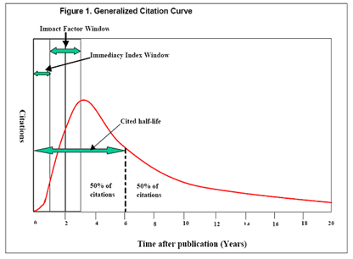
Citation measures
ISI indicators:
  cited half-life: measure of the rate of decline of the citation curve
  Impact factor: relative size of the citation curve in years 2 and 3
  immediacy index: measure of the skewness of the citation curve
Generalized citation curve

Slide 37
Impact Factor
Definition of Impact Factor
http://scientific.thomson.com/free/essays/journalcitationreports/impactfactor/)
The impact factor is defined as
So
The impact factor can be thought of as the average number of times a paper in that journal is cited, for example:
If 100 papers are published and each is cited by someone once, the impact factor of the journal would be = 1.
One main aim is to publish only high quality papers as these are more likely to be cited. Review articles are more likely to receive a greater number of citations than ordinary articles.
Extrapolating: If only one paper in two years is published, but it receives 3 cites, then the impact factor would be = 3!

Slide 38
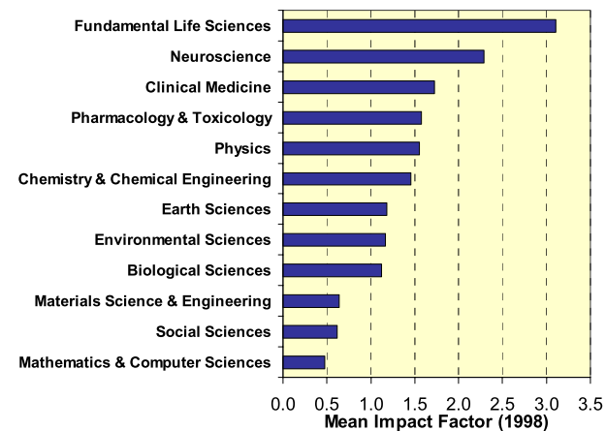
Influencing the Impact Factor
Subject Area
Fundamental and pure subject areas have higher impact factors
M. Amin & M. Mabe (2000), Impact Factors: Use and Abuse, Perspectives in Publishing

Slide 39
Influencing the Impact Factor
Number of Authors
Average no. of authors per paper
Social sciences: 2
Natural sciences: 4
Authors tend to refer to their own work
M. Amin & M. Mabe (2000), Impact Factors: Use and Abuse, Perspectives in Publishing

Slide 40
Influencing the Impact Factor
Type of Article
M. Amin & M. Mabe (2000), Impact Factors: Use and Abuse, Perspectives in Publishing

Slide 41
Online First Influence on Impact Factor
IF 2011
Published by ISI
Cited papers
Cited period
2008
2009
2010
2011
2012
No. of Papers
First online paper to appear in print in 2009
Period in which author writes papers appearing in print in 2009
Online First publication influences the impact factor postively

Slide 42
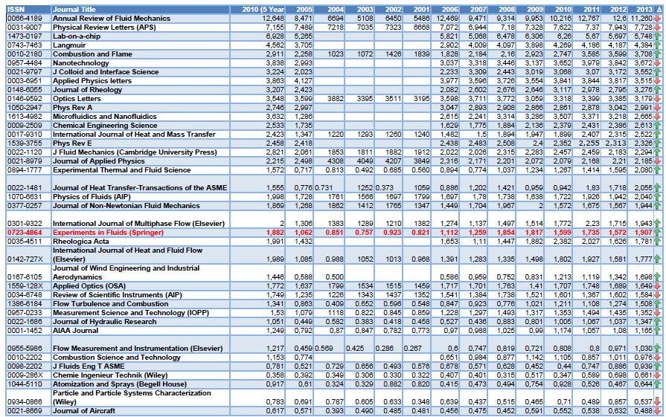
Impact Factor

Slide 43
Pages published
The ISI monitors the number of issues and the dates of publication of each issue. These are fixed and cannot be changed during that year. Failure to publish on time (within two weeks) of each issue can be cause for dismissal from ISI, with resulting serious consequences for both the journal and the publisher.

Slide 44
Contents
Self-Introduction
Aims of the Editorial Staff, Scope statement
Submission Step
  Ethical Standards
  Suggested referees
Peer-Review Process
  General description
  Selection of reviewers
  Difficult judgements, adjudication
Editorial staff - composition
Measures of evaluation
Editor / publisher
  Statistics, production
  Marketing
Discussion, Questions and Answers

Slide 45
Editors‘ Pipeline

Slide 46
Marketing Goals
Marketing Instruments
Electronic Marketing
    E-mailing
    Free trial period on internet
ENewsletter & Announcements
TOC Alert program
Conference table-top displays,
Delegate bag inserts
Conference special issue
Poster
Increase
online
usage
Attract
high-quality
papers
Increase
Impact
Factor
Sustain
high world-
wide visibility

Slide 47
Downloads 2011 - 2014
Fulltext Article Requests 2011-2014
Totals
2011 | 276,140
2012 | 329,209
2013 | 289,144
2014 | 260,478
(Source: SpringerLink.)

Slide 48
Usage
Full-Text Article Requests by External Referral: Jan to Nov 2010*
Search Engines
Google | 65%
Yahoo | 0%
AOL Search | 0%
Other | 1%
Libraries & Universities
Lib. & Univ. Web Sites | 7%
ExLibris SFX | 6%
Serials Solutions | 2%
Other | 1%
A&I Databases
Web of Knowledge | 2%
Scopus | 1%
ADS | 1%
Other | 2%

Slide 49
Contents
Self-Introduction
Aims of the Editorial Staff, Scope statement
Submission Step
  Ethical Standards
  Suggested referees
Peer-Review Process
  General description
  Selection of reviewers
  Difficult judgements, adjudication
Editorial staff - composition
Measures of evaluation
Editor / publisher
  Statistics, production
  Marketing
Discussion, Questions and Answers

Slide 50


Thank you very much for your attention
Prof. Dr.-Ing. Cameron Tropea
Fachgebiet Strömungslehre und Aerodynamik
Center of Smart Interfaces
Technische Universität Darmstadt
Alarich-Weiß-Straße 10,
64287 Darmstadt, Germany
Tel: +49 6151 16 4168
FAX: +49 6151 16 4754
Email: ctropea@sla.tu-darmstadt.de
www.sla.tu-darmstadt.de
www.csi.tu-darmstadt.de
SLA

